Slide 1
Group Project – OMIS 645
Applied Business Analytics SAS Darshan Kumar
Ritesh Boda
Durgaprasad
Syed Sujauddin Professor: Kishen Iyengar

Slide 2
Agenda
Introduction
Variables Involved
Discussion on Questions
Findings & Analysis
Conclusion

Slide 3
Introduction
Analysis on a New York School Quality Dataset. The dataset includes information on over 450 public schools in New York City.
Analyzing this dataset can provide valuable insights into the factors that contribute to the success of public schools.
We analyzed the dataset to gain a deeper understanding of the factors that effects Leadership, Quality of Curriculum, Student Achievement Rate etc.

Slide 4
Variables Involved
Economic Need Index
Years of Principal experience at this school
Teacher's attendance rate
Collaborative Teachers %
Effective School Leadership %
Trust %
Rigorous Instruction %
Effective School Leadership
Supportive Environment

Slide 5
Question:
What factors influence chronic absenteeism in the schools of New York State? How can we limit absenteeism and increase student attendance in schools?

Slide 6
To look at the variables that influence chronic Absenteeism in the schools of New York. We used variables such as:
Economic Need Index
Years of Principal experience at this school
Teachers attendance rate.
Average Grade 8 Math Proficiency.

Slide 7
Moreover, we used a factor (Instructional Quality) in this Analysis.
Collaborative Teachers %
Effective School Leadership %
Trust %
Rigorous Instruction %

Slide 8
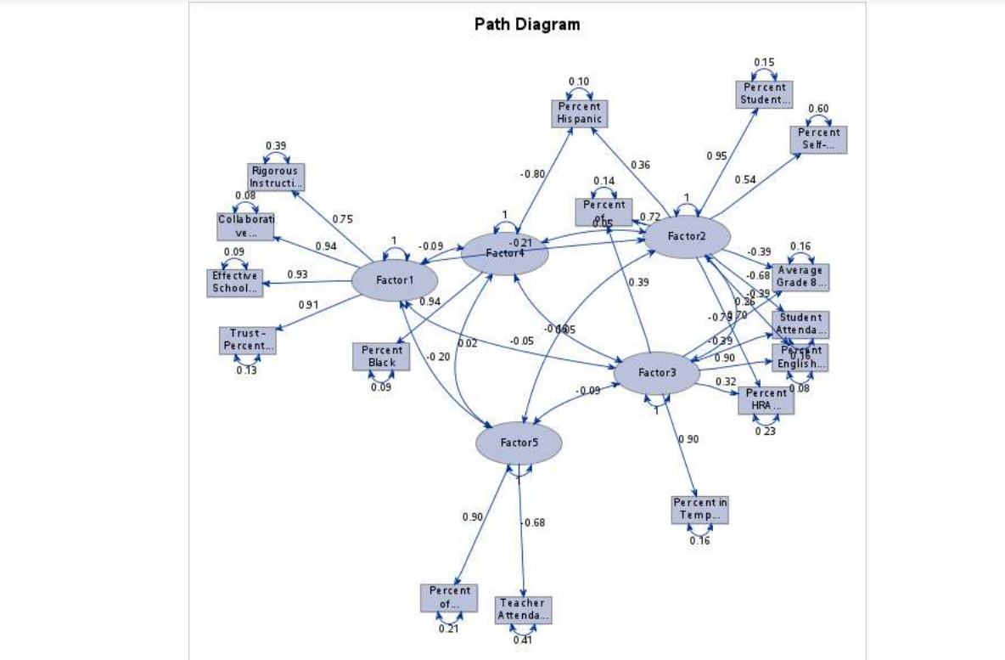

Slide 9
The overall Model is Significant
Adjusted R Square – 61.59% , so 61.59% of the variation in variable chronic absenteeism is explained be our Independent Variables. Also, the model is a good fit.
All our Independent Variables are significant as well.
Our Biggest predictor of the Model is Average grade 8 Proficiency.

Slide 10
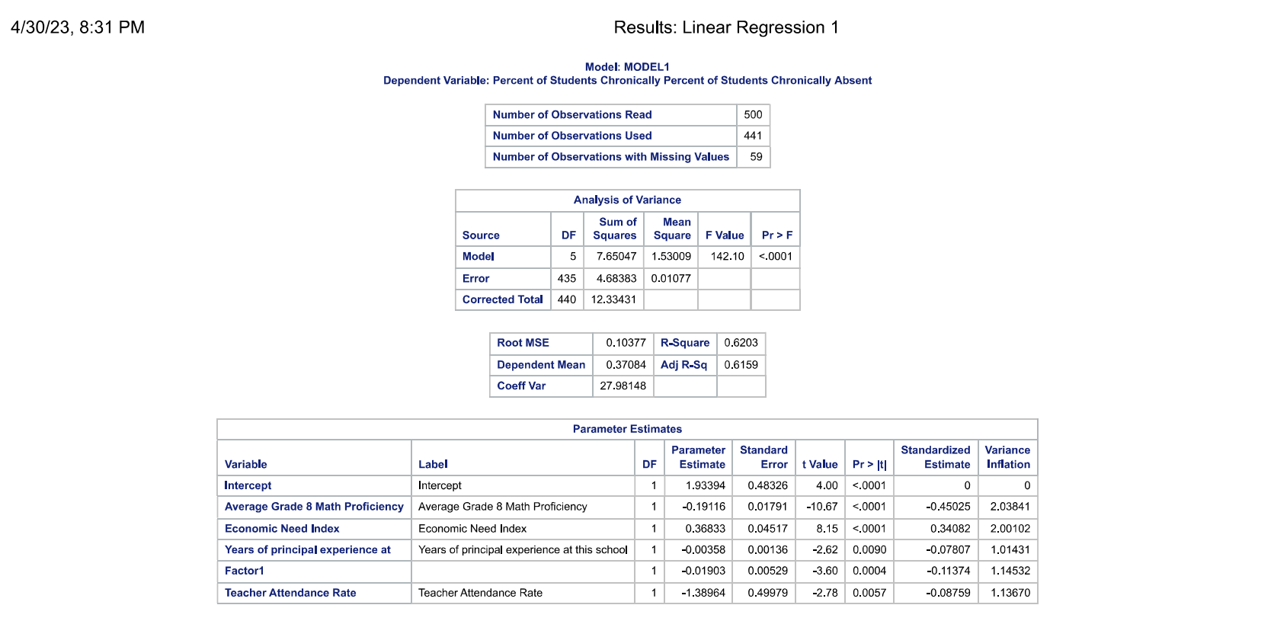

Slide 11
Chronic Absenteeism = 1.93394 -0.19116 (Average grade 8 Math Proficiency) + 0.36833 (Economic needs Index) – 0.00358( Years of Principal experience at this school) – 0.01903( Factor 1) -1.38964 ( Teacher Attendance Rate) + E

Slide 12
Assumptions:
The Residuals are normally Distributed.
The Residuals are homoscedastic.
There is no autocorrelation, as it is not a time series Data.
Observation 124 has to be removed, as it is an outlier and leverage point, and is affecting out analysis.

Slide 13
How can we limit absenteeism and increase student attendance in schools?
Correlation Between, Attendance Rate and Absenteeism.
Moderation - Average Grade 8 math Proficiency

Slide 14
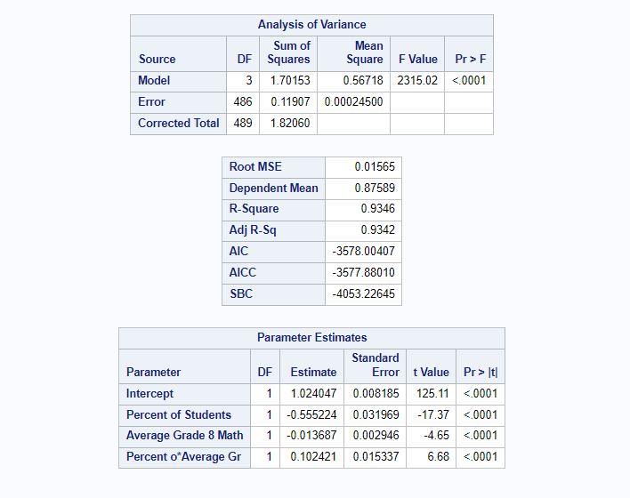

Slide 15
Question:
Does student achievement rating depend on the quality of how interesting and challenging the curriculum of a school in New York state is?

Slide 16
Null Hypothesis – Student achievement does not depend on the quality of how interesting and challenging the curriculum of a school in New York state is.
Alternative Hypothesis - Student achievement depends on the quality of how interesting and challenging the curriculum of a school in New York state is.

Slide 17
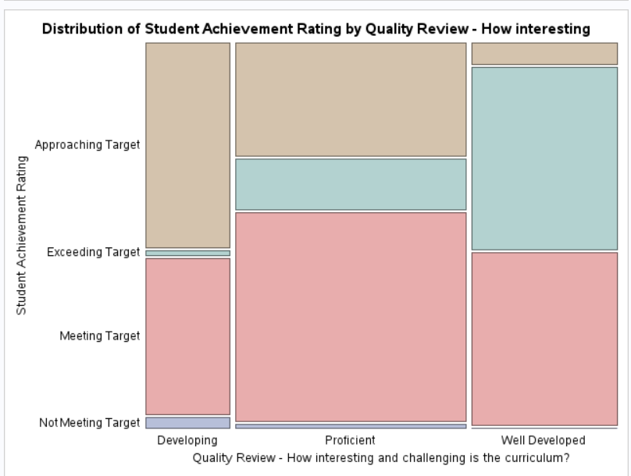
By looking at the P-value of the Chi-square value, we conclude that both the variables are dependent.

Slide 18
Question:
What explains the Trust of a school in New York State?

Slide 19
In this analysis, we identified variables that contribute to variation in trust among schools in New York State are.
Rigorous Instruction
Collaborative Teaching
Supportive Environment
Economic Need Index
Percent of teachers with 3 plus yrs of exp
Strong Family-Community ties (Categorical)

Slide 20
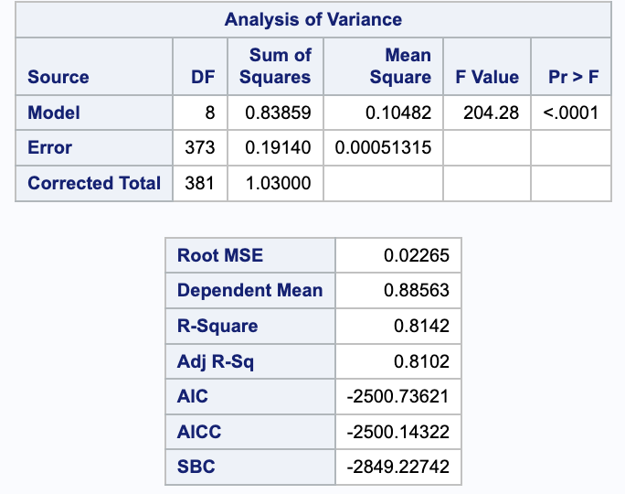

Slide 21
The model is statistically significant and explains a significant amount of variability in the Trust.
The model explains approximately 81.02% of the variance in the dependent variable "Trust - Percent Positive" based on the independent variables included in the model.

Slide 22
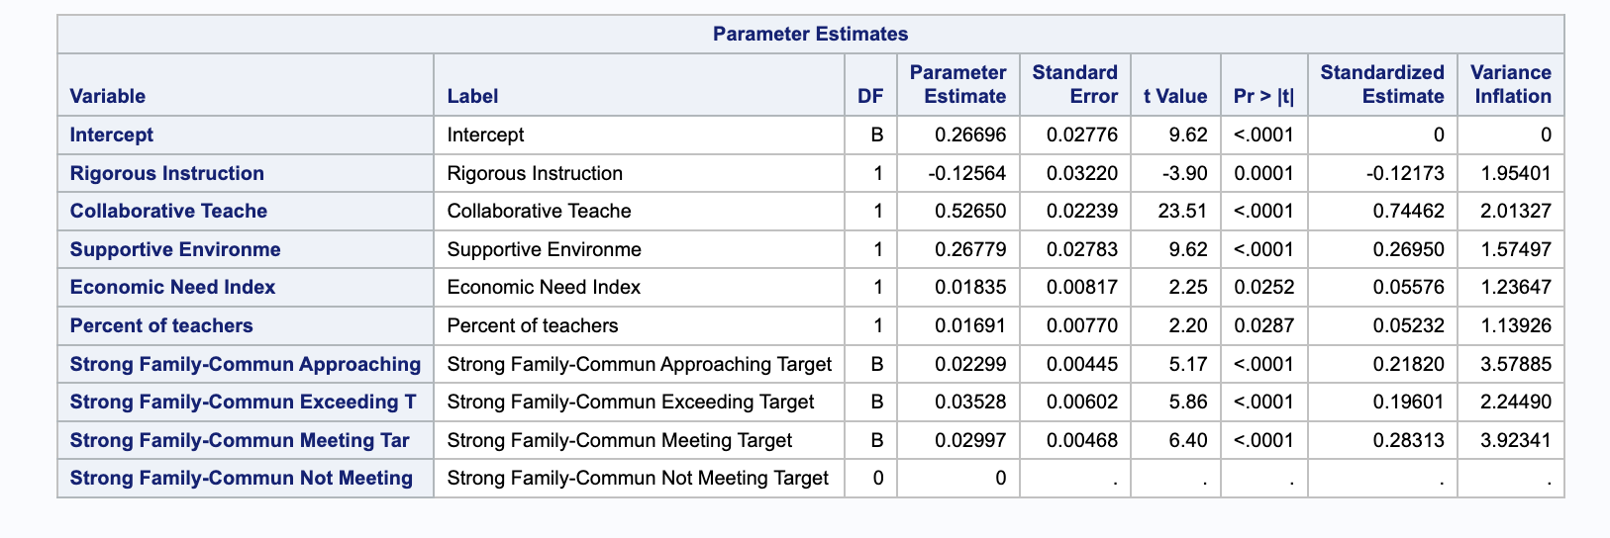

Slide 23
Based on the standardized estimates, Collaborative Teaching is the highest predictor of trust among schools in New York State.
Assumptions:
The Residuals are normally Distributed.
The Residuals are homoscedastic.
There is no autocorrelation, as it is not a time series Data

Slide 24
Conclusion
To improve trust in schools in New York State, we recommend improving collaborative teaching and the supportive environment of schools. Other factors, such as rigorous instruction, economic need index, and experienced teachers, also have an impact on trust, but to a lesser degree.

Slide 25
Question:
Does Years of Principal at the same school moderate the relationship between Supportive Environment and Effective School Leadership?

Slide 26
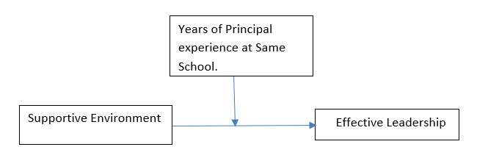
Logical Diagram

Slide 27
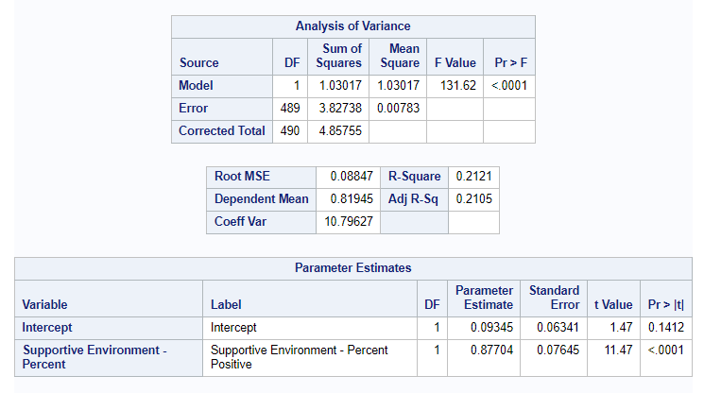
Individual Effect

Slide 28
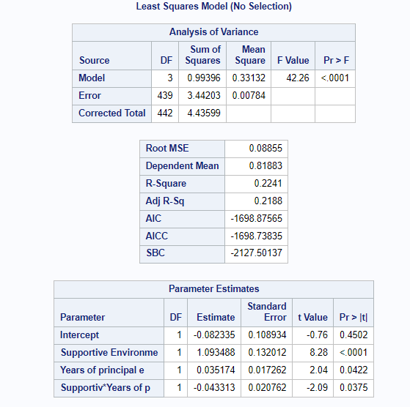
Moderation Effect

Slide 29
Analysis
Supportive Environment in a school can tell us how Effective the School Leadership can be.
So, the effect of school leadership is being dampened by this moderator, though there is a good percent of supportive environment.
So, the analysis suggests that there should not be constant Principal in a school for a better Leadership.

Slide 30
References
https://catalog.data.gov/dataset/2014-2015-school-quality-reports-results-for-high-schools

Slide 31

Thank You

